Slide 1
PhpMyAdmin is a free software tool written in PHP, intended to handle the administration of MySQL over the Web. phpMyAdmin supports a wide range of operations on MySQL and MariaDB. Frequently used operations (managing databases, tables, columns, relations, indexes, users, permissions, etc) can be performed via the user interface, while you still have the ability to directly execute any SQL statement.

Slide 2
Install PHPMYADMIN
sudo apt-get install phpmyadmin

Slide 3
Connecting PHPmyadmin with apache
cd /etc/apache2
sudo gedit apache2.conf
Include /etc/phpmyadmin/apache.conf

Slide 4
Database Connectivity
cd /var/www
sudo gedit db.php
<?php
echo "test";
$con = mysqli_connect("localhost","root","user123");
print "connection created with databse";
if (!$con)
{
die('Could not connect: '. mysqli_connect_error());
}
mysqli_close($con);
?>

Slide 5
Database Creation
cd /var/www
sudo gedit db.php
<?php
$con = mysql_connect("localhost","root","user123");
if(!$con)
{
die('Could not connect: ' . mysql_connect_error());
}
if(mysql_query("CREATE DATABASE tan",$con))
{
echo "Database created";
}
else
{
echo "Error creating database: " . mysql_connect_error();
}
?>

Slide 6
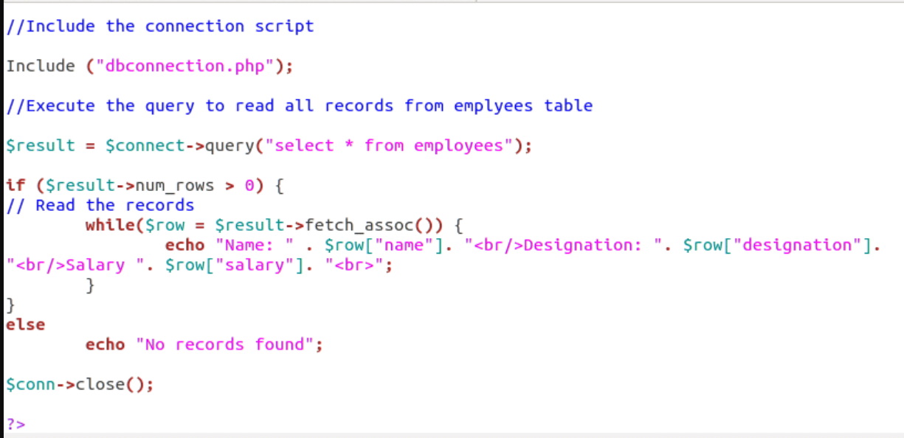

Slide 7
Table Creation
cd /var/www
sudo gedit tbcrte.php
<?php
$con = mysql_connect("localhost","root","user123");
if (!$con)
{
die('Could not connect: ' . mysql_error());
}
mysql_select_db("tan", $con);
$sql = "create table student
(
stuName varchar(15),
stuSurName varchar(15),
Age int
)";
echo "table student created successfully";
mysql_query($sql,$con);
mysql_close($con);
?>

Slide 8
Insert Values
cd /var/www
sudo gedit insrt.php
<?php
$con = mysql_connect("localhost","root","user123");
if (!$con)
{
die('Could not connect: ' . mysql_error());
}
mysql_select_db("tan", $con);
mysql_query("INSERT INTO student (stuName, stuSurName, Age)
VALUES ('abc', 'xyz', '15')");
mysql_query("INSERT INTO student (stuName, stuSurName, Age)
VALUES ('GHI', 'QRS', '13')");
mysql_close($con);
?>

Slide 9
Database Connectivity
<?php
$servername=“localhost”;
$username=“root”;
$password=“yourpwd”;
$dbname=“db1”;
$conn=new mysqli($servername,$username,$password,$dbname);
If($conn->connect_error)
{die(“connection failed”.$conn->connect_error);}
Else
Echo “connectionbuilt”
If ($conn->query(“Create database db2”))
{
Echo “database created”;
}
Else
Echo “error caught”;
}}
$conn->close();

Slide 10
Create a connection
<?php
$servername = "localhost";
$username = "root";
$password = "123";
$dbname = "myDB";
// Create connection
$conn = new mysqli($servername, $username, $password, $dbname);
// Check connection
if ($conn->connect_error) {
die("Connection failed: " . $conn->connect_error);
}
Echo “connection built”;

Slide 11
$a=$_POST[firstname];
echo $a;
$b=$_POST[lastname];
echo $b;
$c=$_POST[email];
$sql = "INSERT INTO MyGuests (firstname, lastname, email) VALUES ('$a','$b','$c')";
if ($conn->query($sql) === TRUE) {
echo "New record created successfully";
} else {
echo "Error: " . $sql . "<br>" . $conn->error;
}
$conn->close();
?>

